Slide 1

Exodus, Why?
Exodus 19:4-6

Slide 2
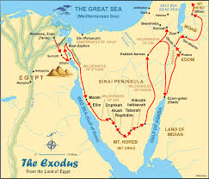
Questions
Why did God save the Israelites from Egypt?
What was the purpose of the Exodus?

Slide 3
Theme of the Five Books (5 W)
Genesis | Exodus | Leviticus | Numbers | Deuteronomy
World (creation) | Works (salvation) | Worship (holiness) | Wilderness (training) | Word (preaching)

Slide 4
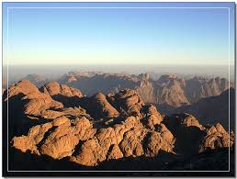
Structure of Exodus
Exod 1------------------- 18 | Exod 19--------- Lev, Num 9 | Num 10----------Deut 34
Egypt to Mt. Sinai | In Mt. Sinai | Mt. Sinai to Moab
3 months | 11 months 10 days | 38 years

Slide 5
Purpose of Exodus
Exodus 19:4-6, You yourselves have seen what I did to Egypt, and how I carried you on eagles’ wings and brought you to my self (4). Now if you obey me fully and keep my covenant, then out of all nations you will my treasured possession(5). You will be for me a kingdom of priests and a holy nation (6)
Exod 19:4 | Exod 19:5 | Exod 19:6
Carried you on the eagles’ wings | Obey me fully and keep my covenant | Kingdom of priests and holy nation
Past (already done) Salvation by grace | Present (Now) To be holy by obeying and keeping covenant | Future To establish Kingdom of God

Slide 6
1) Salvation
. What is salvation?
From the Bondage of Pharoah (political) | From the gods and idolatry (10 Plagues) (spiritual) | From the Sea of Death (Red Sea) (natural) | From the Suffering of Desert (physical)
Exod 1-6 | Exod 7-11 | Exod 12-14 | Exod 15-18

Slide 7
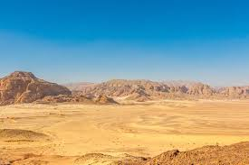
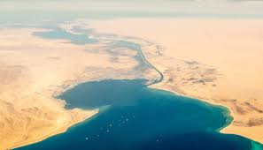
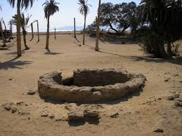
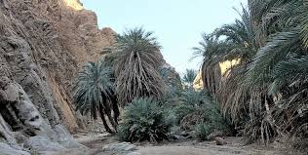
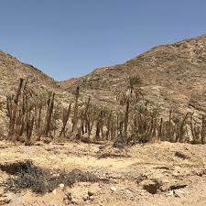
Red Sea, Desert, Marah, Elim, Rephidim

Slide 8
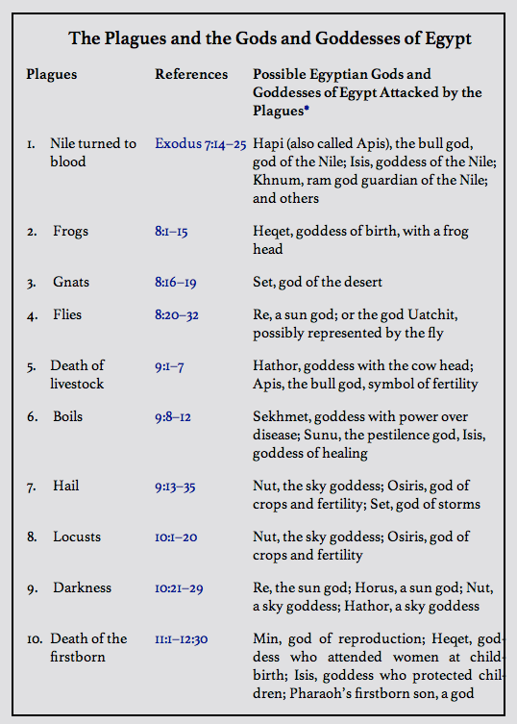
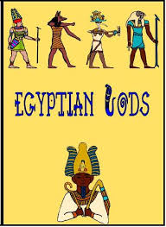
10 plagues and Egyptian gods

Slide 9
Ephesian 2:8, ‘For it is by grace you have been saved, through faith, and this is not from yourselves, it is the gift of God’
Col 1:13, ‘For he has rescued us from the dominion of darkness and brought us into the kingdom of the Son he loves’
Have you already got salvation?
From what?

Slide 10
2) Holiness
Law (Exod 20-24) |  | Tabernacle (Exod 25-40)
Exod 20 (Love God) | Exod 21-24 (Love Neighbors) | Yard | Holy Place | Holies of Holy
Ten Commandments and 613 laws | Civil laws (Freedom of slaves, refuge, social justice) | Altar of Burnt Offering Bronze laver | Table of Bread Altar of Incense Golden Lampstand | Ark (Stone tablets of 10 Commandments, Aron’s rod that budded, Pot filled with manna)

Slide 11
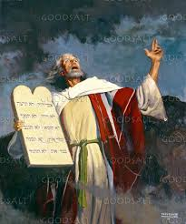
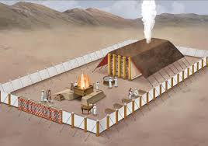
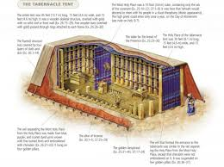
Law and Tabernacle

Slide 12
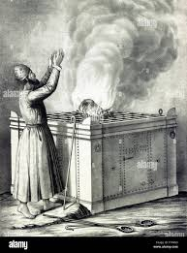
Five Offerings
Burnt Offering | 1:3-17 | Bull, sheep, goat, complete dedication
Grain Offering | 2:1-16 | Fine flour with oil, salt. perfect devotion
Peace Offering | 3:1-17 | Sheep, goat, fellowhip with God and Man
Sin Offering | 4:1-5:13 | Bull, sheep, goat, atone for unknown sins
Guilt Offering | 5:14-6:7 | Bull, sheep, goat, atone for intentional sins

Slide 13
How do we become holy?
Law (Word)
Tabernacle (Worship)
. 5 Hands of the Word
Reading, Hearing, Studying, Meditation, Memorizing
. Reading (SPEAK)
Sin, Promise, Encourage, Action, Knowledge on God
5 P of Worship
. Preparation of Heart
. Praising with Prayer
. Proclamation of Word
. Presence of Holy Spirit
. Participation in Mission

Slide 14
3) Kingdom of Priests
O.T | N.T
Kingdom of Priests for Israel | Kingdom of God for all nations
Exodus | Israel | Jesus | Church | Revelation
Kingdom of Priests (Exodus 19:4-6) | Kingdom of Israel (1 Sam-2 Chronicle) | Establishment of Kingdom of God (Gospel) | Proclamation of the Kingdom of God (Acts-Present) | New Heaven and New Earth, New Jerusalem (Revelation 21:1-8)

Slide 15
Five Great Commission
Matt 28:19-20 | Mark 16:15-16 | Lk24:45-47 | John 20:21-23 | Act 1:8
Go, make disciples and teach to obey | All nations and all creation. Salvation and condemnation | His Death, Resurrection and Forgiveness | I am sending you, receive the Holy Spirit | You will be my witnesses with the power of Holy Spirit

Slide 16
Summary and Application
 | Past | Present | Future
Exodus 19:4-6 | Salvation (4) | Holiness (5) | Kingdom (6)
Your application

